Slide 1

Cloud-Based Crop Disease Detection and Yield Prediction Using Deep Learning
A comprehensive deep learning solution for automated disease identification and yield forecasting, empowering farmers with real-time insights for precision agriculture.
Panchumarthi SumaDanika
RA2412033010044

Slide 2
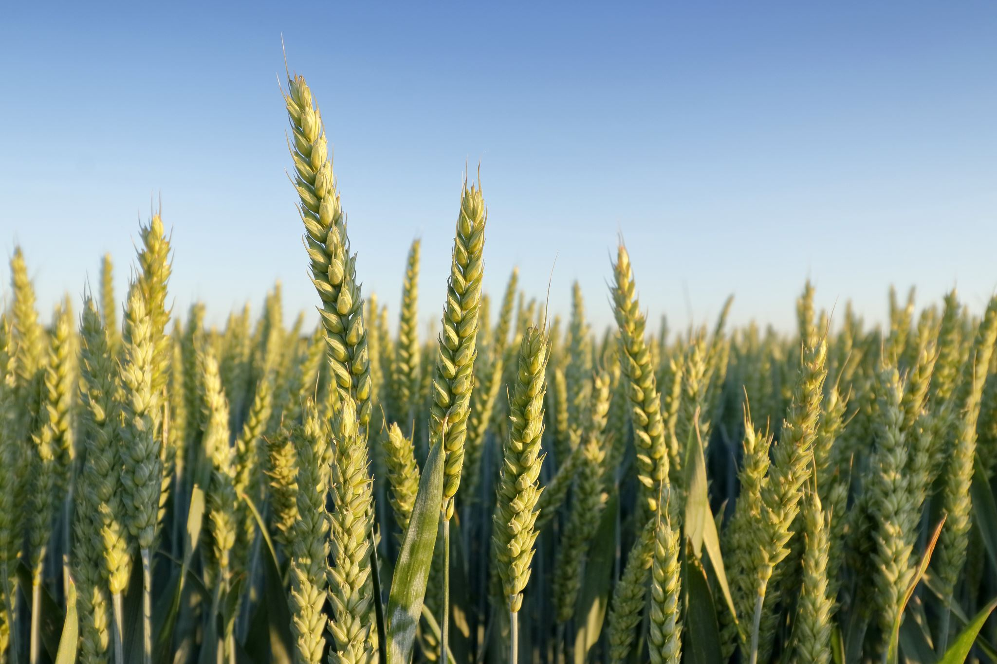
INTRODUCTION
Agriculture is vital for global food security, but crop diseases cause major yield losses every year.
Traditional disease detection methods are manual, time-consuming, and require expert knowledge.
Deep Learning, especially Convolutional Neural Networks (CNNs), enables automatic and accurate disease identification from crop images.
Cloud Computing allows real-time data upload, processing, and prediction — accessible from anywhere.
This project integrates AI and Cloud Technologies to:
1. Detect crop diseases early, Predict yield accurately, and Help farmers make data-driven decisions.
The system promotes smart agriculture, cost efficiency, and sustainable farming practices.

Slide 3
MOTIVATION
Agriculture faces huge losses due to late or inaccurate detection of plant diseases.
Manual inspection of crops is difficult for large-scale farming and depends on expert availability.
Farmers need a reliable, automated, and accessible system to detect diseases early and predict yield.
Rapid advances in Deep Learning and Cloud Computing provide powerful tools for real-time analysis.
Integrating these technologies can:
1. Reduce dependency on human expertise,
2. Save time and cost, and
3. Improve crop health management.
The motivation is to empower farmers with smart, AI-based decision support for sustainable agriculture.

Slide 4
Understanding the Present System and its Challenges
Present System
Challenges /Limitations
Manual observation by farmers or agricultural experts
Basic mobile apps or offline image-based tools
Local storage or device-based systems
Requires on-site experts for diagnosis
Mostly manual or semi-automated
Rarely included in existing systems
Time-consuming, error-prone, and dependent on human expertise
Limited accuracy, not scalable, lack of real-time processing
Data loss risk, no centralized storage or data sharing
Difficult to access in rural or remote areas
Lacks full automation and intelligent decision support
Farmers cannot estimate future yield accurately

Slide 5
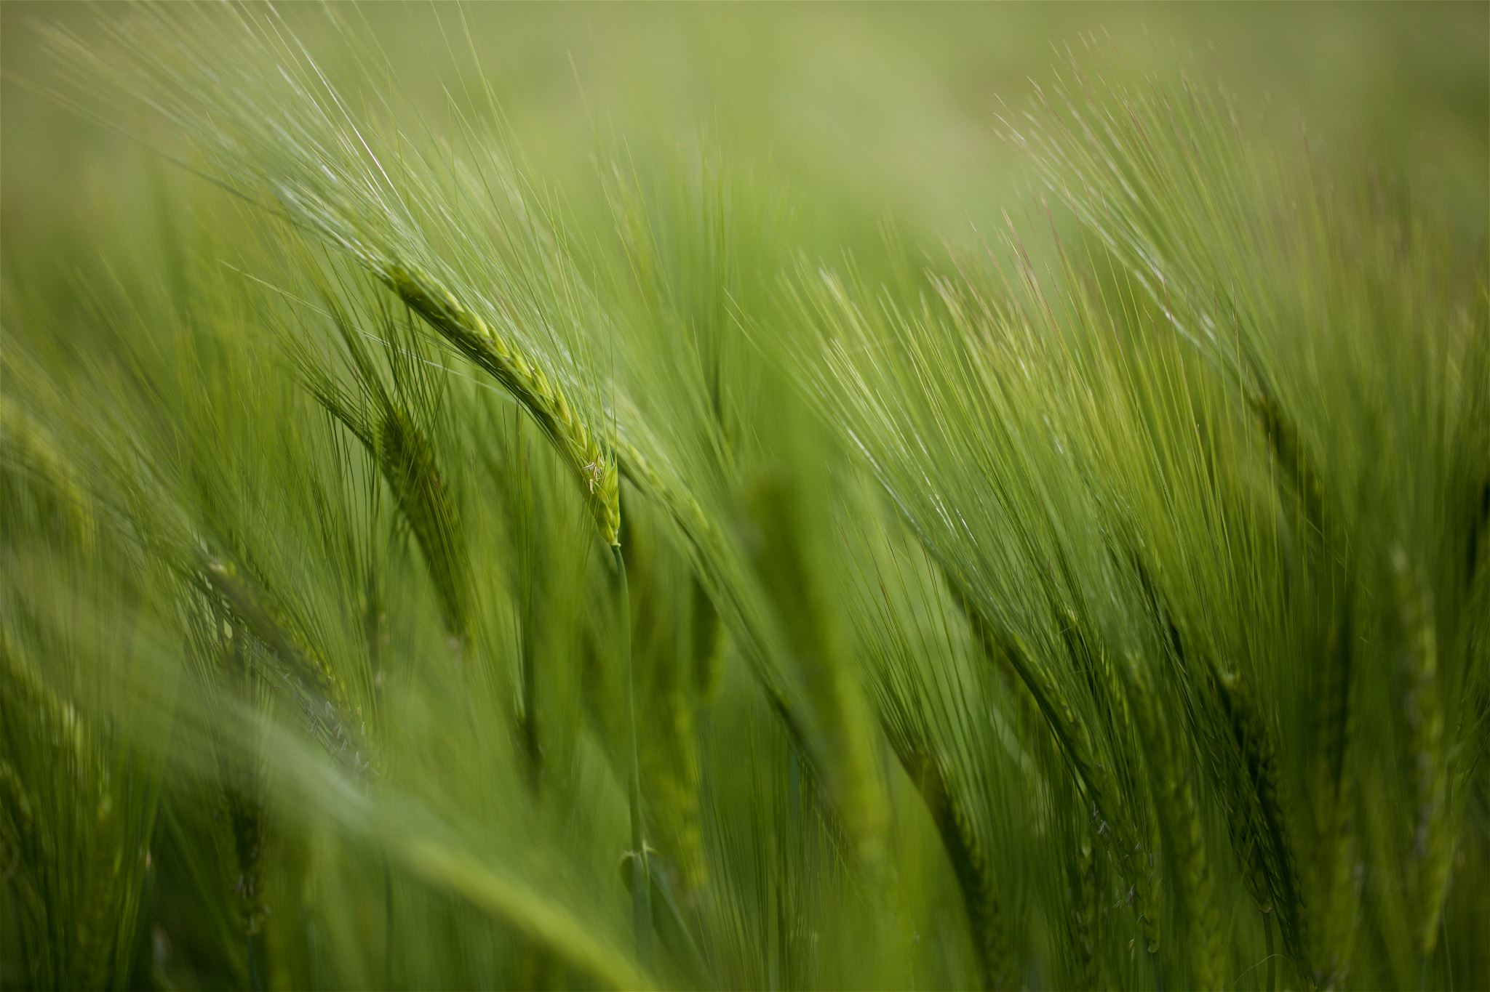
INNOVATION OF THE PROJECT
The proposed system introduces a novel integration of Deep Learning and Cloud Computing technologies to address the major issues faced in modern agriculture. Unlike traditional methods that rely on manual observation or offline tools, this project offers a real-time, automated, and intelligent solution for detecting crop diseases and predicting yield outcomes.
The innovation lies in combining Convolutional Neural Networks (CNNs) for precise image-based disease classification with cloud-based infrastructure for scalable processing and storage. Farmers can capture leaf images using mobile devices, which are then uploaded to the cloud platform for instant analysis and diagnosis.
By deploying the model on the cloud, the project ensures accessibility from any location, centralized data management, and continuous improvement through model retraining with new datasets. The integration of AI and Cloud technology reduces the need for expert supervision, minimizes human error, and accelerates the decision-making process.
In essence, the project represents a step forward in smart farming, promoting precision agriculture, cost efficiency, and sustainability through intelligent automation.

Slide 6
PURPOSE OF THE PROJECT
The primary purpose of this project is to empower farmers and agricultural stakeholders with an efficient, accurate, and accessible system for crop disease management and yield forecasting. Crop diseases are among the leading causes of global food loss, and timely detection is crucial for ensuring food security and farmer profitability.
This project aims to develop a technological framework that leverages Deep Learning algorithms to detect diseases in plant leaves automatically and Cloud Computing to make the system available to users worldwide without requiring high-end local infrastructure.
By enabling early disease detection, the system allows farmers to take preventive and corrective measures, reducing the spread of infections and improving overall productivity. The addition of yield prediction capabilities helps farmers make data-informed decisions on irrigation, fertilization, and market planning.

Slide 7
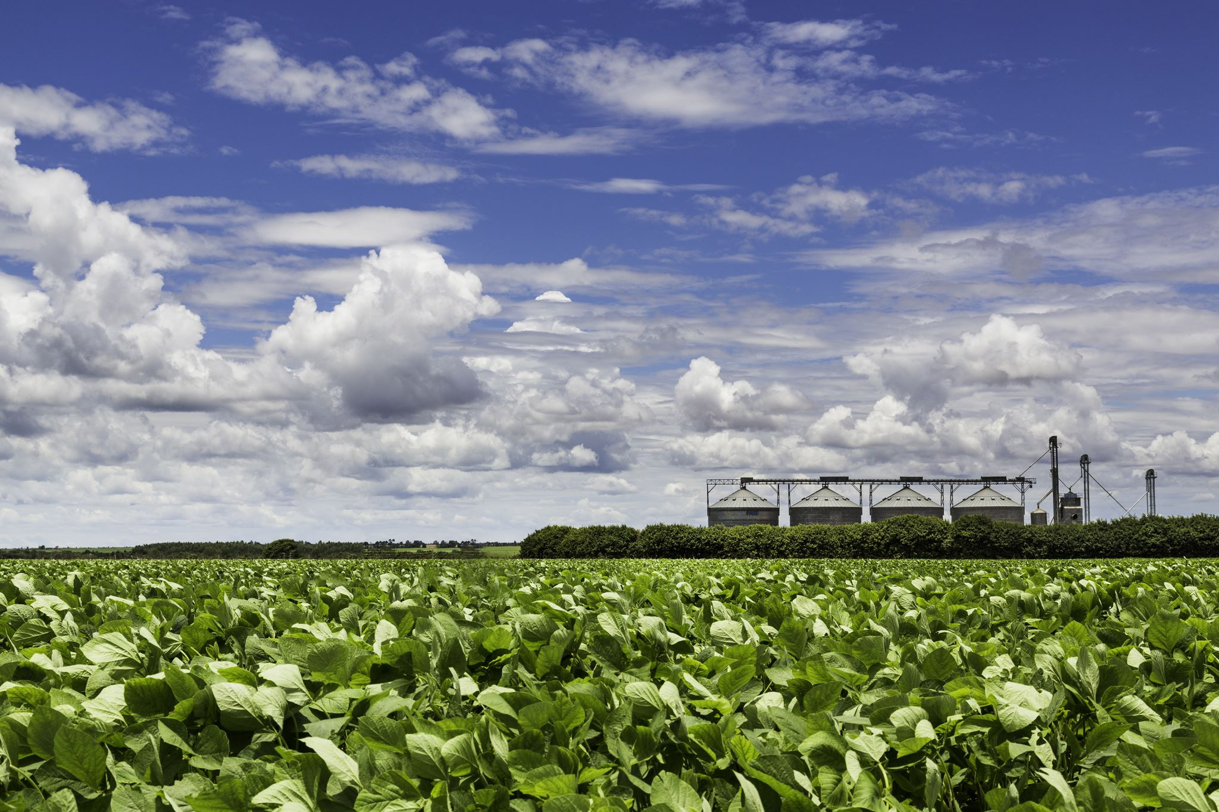
PURPOSE OF THE PROJECT
Another major purpose is to bridge the knowledge and accessibility gap between farmers in rural areas and agricultural experts. With a cloud-based platform, even those in remote locations can benefit from instant analysis without relying on expert availability.
Ultimately, the project seeks to:
Enhance agricultural productivity and sustainability,
Reduce time and cost associated with manual crop inspection, and
Support the vision of digital and precision agriculture through advanced AI integration.

Slide 8
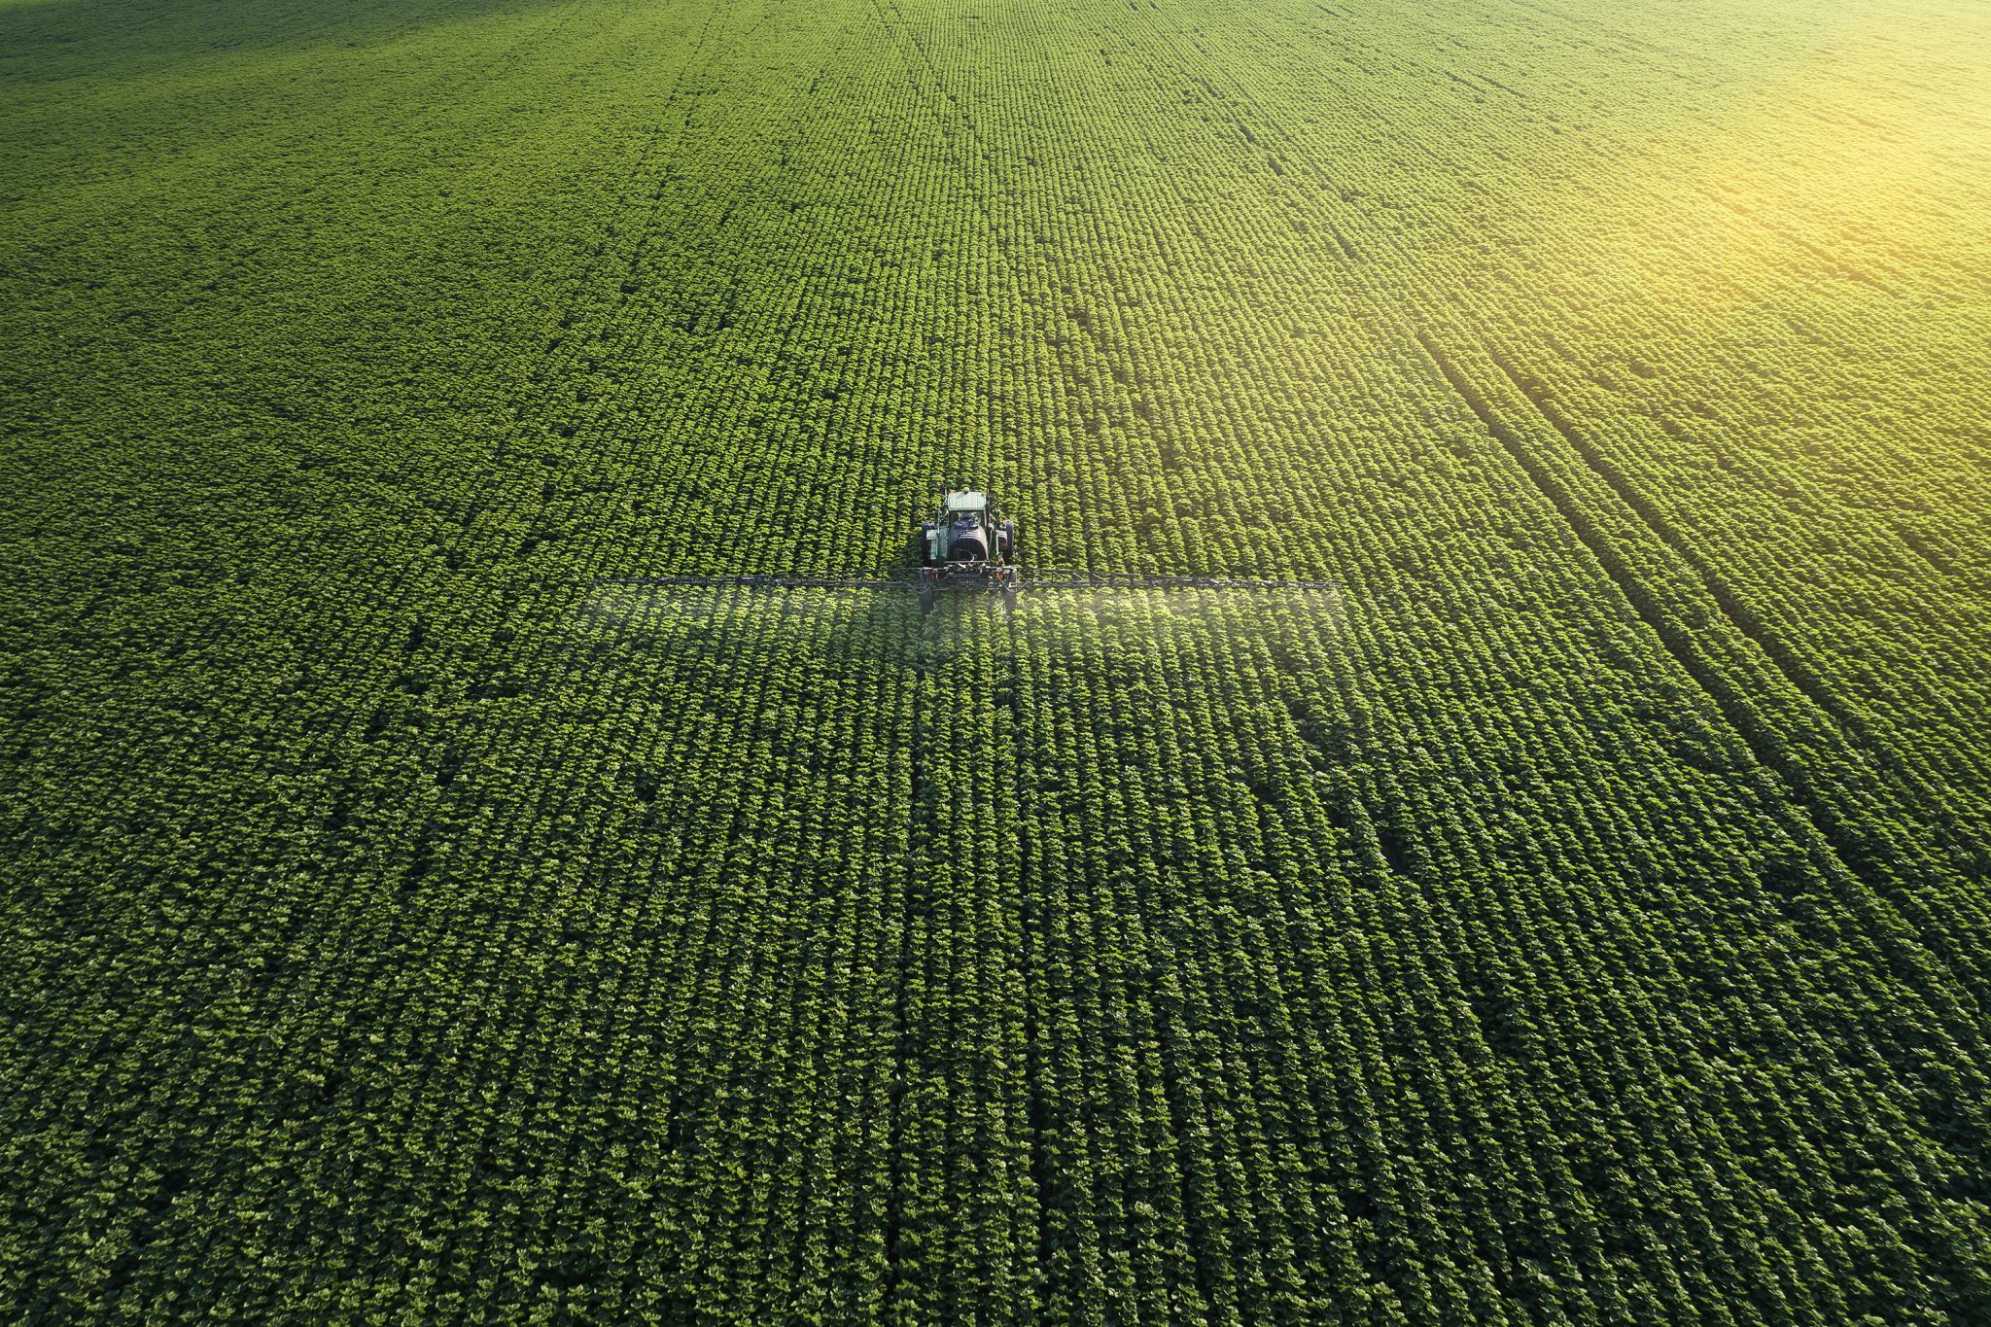
SCOPE OF THE PROJECT
The scope of this project extends across multiple domains of smart agriculture, AI-driven decision-making, and cloud-based deployment. It is designed to serve as a comprehensive platform that caters to the needs of farmers, agricultural researchers, and policy planners.
The system can be applied to a wide range of crops and disease categories, provided sufficient image data is available for model training. Through Deep Learning algorithms such as CNNs, it can identify specific disease patterns from leaf images and classify them into categories like bacterial, viral, or fungal infections.
The cloud infrastructure expands the project’s reach by offering global accessibility, data security, and continuous scalability. Users can upload images from anywhere and receive predictions within seconds, eliminating the need for high computational devices on-site.

Slide 9
SCOPE OF THE PROJECT
The system can be further expanded to include:
Climate-based yield estimation using real-time weather data,
IoT sensor integration for collecting environmental factors like humidity, soil moisture, and temperature,
Data visualization dashboards for monitoring crop health trends over time, and
Decision support modules for recommending fertilizers, pesticides, or irrigation levels.

Slide 10

Thank You

